Slide 1
CSRF Lab Instruction (Do Task 2, 3, 4 only)
Week 8 Session 3

Slide 2

What is Elgg (elgg.org)

Slide 3
How to launch a CSRF attack?
Recall CSRF mimics a CLIENT
Step 1: Observe what does a normal client do?
Need some tools to inspect the HTTP headers (e.g., a browser plugin ‘HTTP Head Live’ or the web develop tool in the browser)
As well as the webpage (e.g., ‘inspect element’ in the browser)
Step 2: Create another attractive webpage
That’s what ‘cross-site’ means
Need to know how to create html pages, the meaning of different tags, etc..
Step 3: Insert what you got from the first step into the webpage.
Redirect to a URL
Use DOM to visit HTML elements
Some Javascript techniques to automate the attack

Slide 4
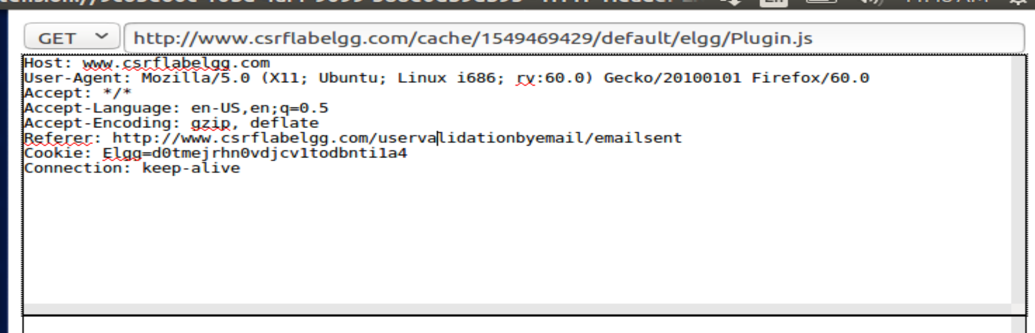
HTTP Header Live
Install the firefox plugin according to the instruction 4.1

Slide 5
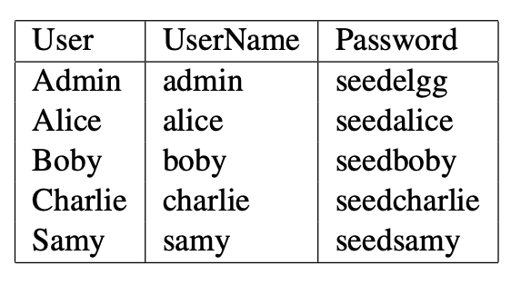
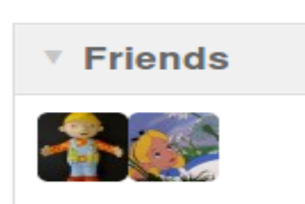
Play with the website
Login http://www.csrflabelgg.com
Don’t try to ‘Register’. This website can NOT really send out emails for registration.
Menu -> Members -> Alice
Click the ‘Add Friend’ button and observe the ‘HTTP Header Live’ window.
Add Alice as a friend of Boby

Slide 6
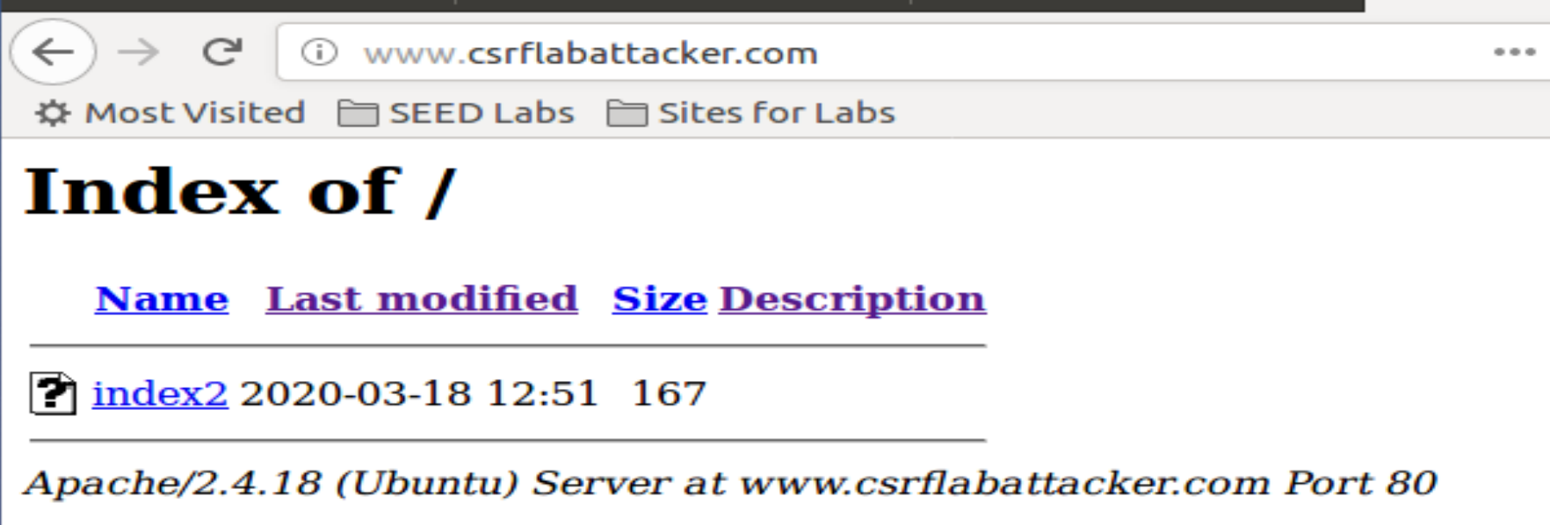
Task 2: Attack through GET
Visit the ‘www.csrflabattacker.com’.
Reason: no webpage in the website folder ‘/var/www/CSRF/attaker/’
Try to create an attractive malicious web page ‘index.html’ and put it under /var/www/CSRF/attacker/index.html .

Slide 7
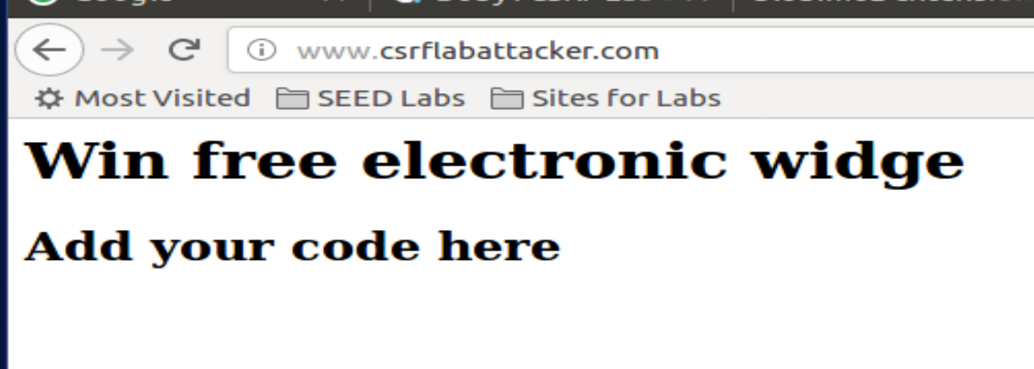
Example: (index.html on eDimension)
Check off
1. Finish the malicious web page (‘task2_index.html’)
2. CSRF should be launched automatically when Alice visits csrflabattacker.com
3. A screenshot of HTTP header Live showing the ‘add friend’ link is actually from the ‘csrflabattacker.com’

Slide 8
Task 3: Attack Through Post
Goal: Modify Alice’s profile using CSRF attack
Step 1: What’s the normal process of editing a Alice’s profile?
Find the URL
Look into the HTTP Header (What’s the difference?)
Step 2: Craft a HTML page that submits a form using POST request
Using HTML form
Using Javascript form
Step 3: Combining information in step 1 and 2 to launch the attack

Slide 9
Example
Example
Using HTML form
Using Javascript form
Hidden
Widow.onload
Checkoff
Based on the template in the document, submit a “task3_index.html”
The form should be generated launched
A HTTP Header Live snapshot showing the success of the attack
Answer the two questions in the docuemnt

Slide 10
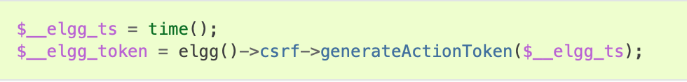
Task 4 Countermeasure
Elgg counters CSRF through security token (md5 message digest)
How to close/open counter measure?
/var/www/CSRF/Elgg/vendor/elgg/elgg/engine/classes/Elgg/actionsService.php
In the function “gatekeeper()” comment “return true” in the first line
Checkoff:
Answer the 4 questions in the document

